Slide 1
Library Management System
Harshal Abak

Slide 2
Contents
Introduction
Problem Statement
Literature Review
Data Base
Source Code
Output…
Conclusion

Slide 3
Introduction
The project “Library Management System” is developed in JAVA, which mainly focuses on basic operations in a library like adding new books, and updating new information, searching books and members and return books.
The main objective of the Library Management System is to manage the details of Address, Member, Issues, Books, Student.
It manages all the information about Address, Librarian, Student, Address.
The project is totally built at administrative end and thus only the administrator is guaranteed the access.

Slide 4
Problem Statement
To create a GUI project to replicate a Library Management System.
To help the administrator manage the records of the members and the books.

Slide 5
Limitations in Existing System
By reading/referring to the existing papers I came to the conclusion that now almost everything that was a limitation earlier was now conquered and solved. Even the method to read books online facility is given by some libraries. So, after reading several papers I decided to shift my focus to a small area where they use traditional pen and paper to store and manage libraries (like in society libraries or in classes or in small schools) where the number of books is less. My Library Management System is a simple GUI-based model which stores the database in SQL and will be user-friendly thus, eliminating the need for pen and paper.

Slide 6
Software Requirements
JAVA IDE (Eclipse)
MySQL
Xampp
JAVA Swing

Slide 7
Data Base
The project contains Test Data Base which contains three SQL Tables
Issue Books
Librarian
Books Data Base

Slide 8
Source Code This project Library contains the following files:
Admin Login
Admin Success
Book DAO
Books Form
DB
Delete Librarian
Issued Book DAO
Librarian Form
Librarian Login
Librarian Success
Library
Return Book
Return Book DAO
View Books
View Issued Books
View Librarian

Slide 9

Output
These are the different interfaces of the project -

Slide 10
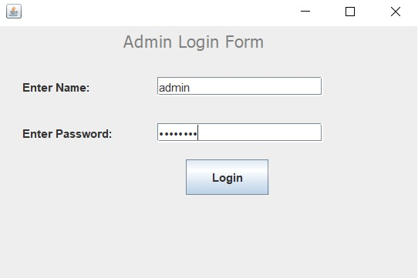
1. Admin login

Slide 11
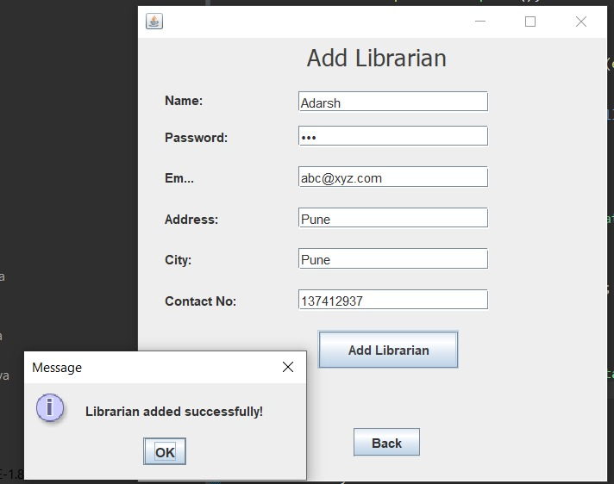
2. Add Librarian

Slide 12
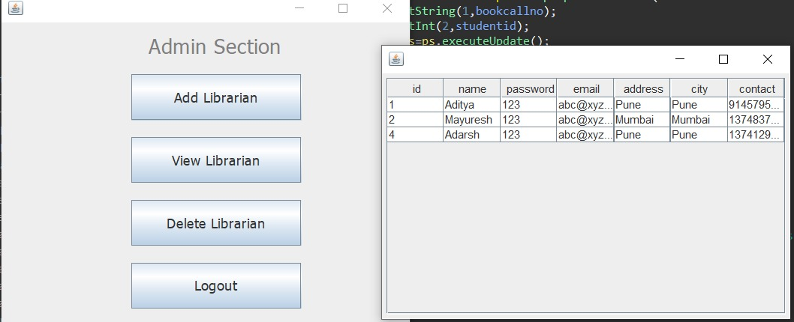
3. View Librarian

Slide 13
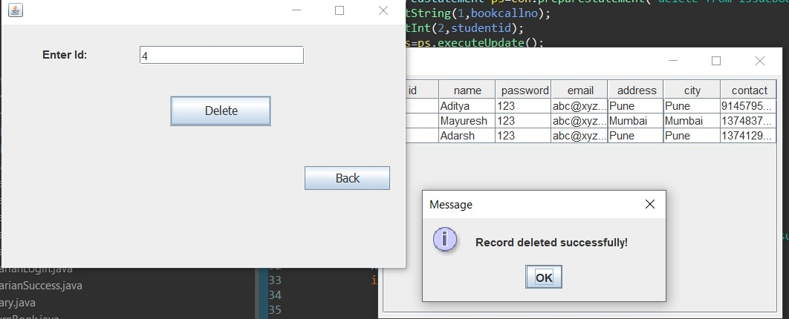
4. Delete Librarian

Slide 14
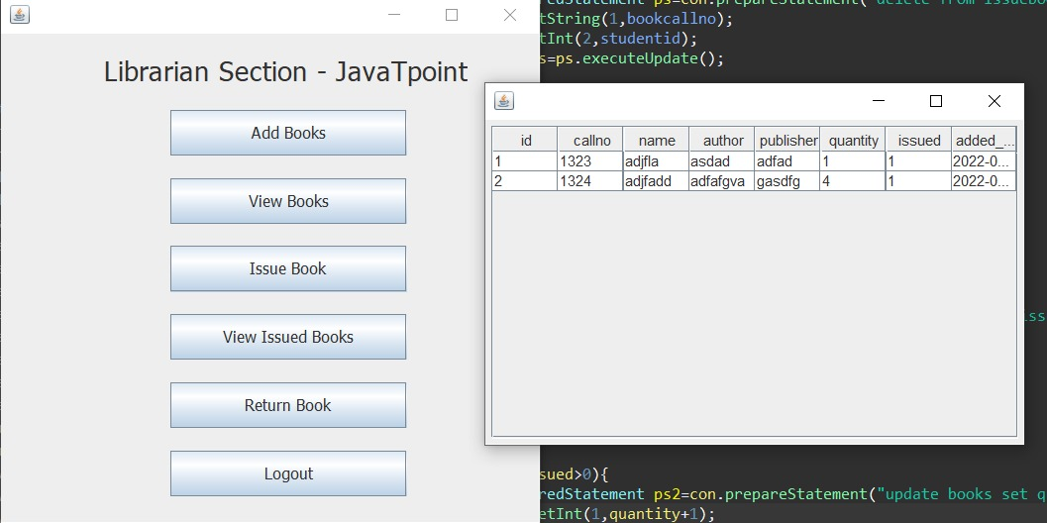
5. View Books

Slide 15
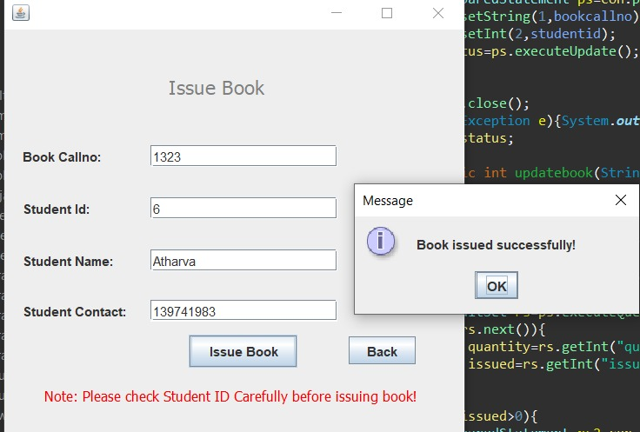
6. Issue Book

Slide 16
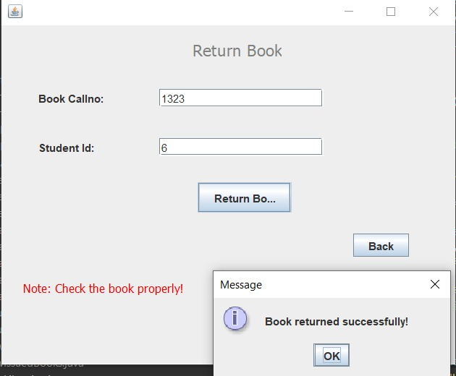
7. Return Book

Slide 17
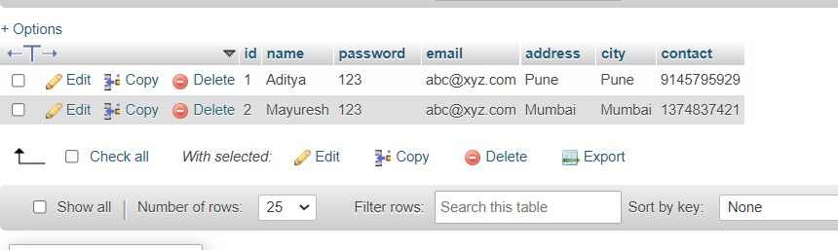
9. Data Base

Slide 18
Conclusion
We are able to manage the data that the user is adding, with the SQL Data Base.
We can view, edit, update, delete the data.
The tables help us to keep the data segregated and better for viewing.
This system can be accessed by the admin with the credentials and they can keep a record of the entities required in a library.

Slide 19
Thanks!
Any questions?

